Slide 1



Slide 2
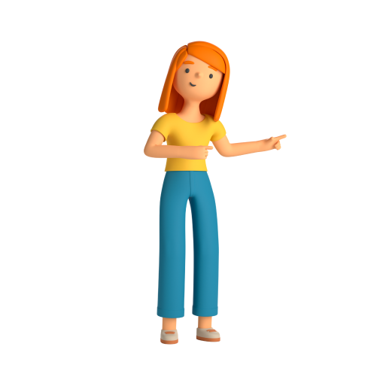
01
idea
03 Tech used
Workflow
02
style guide
05
demo
Overview
04

Slide 3
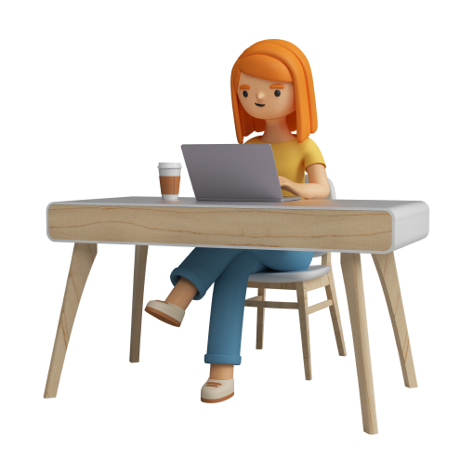
idea
Using EXAMIQ to get an opportunity to get (first 3 months) training in companies
Ex:Company A uses EXAMIQ to search for employee and asses their knowledge by EXAMIQ

Slide 4

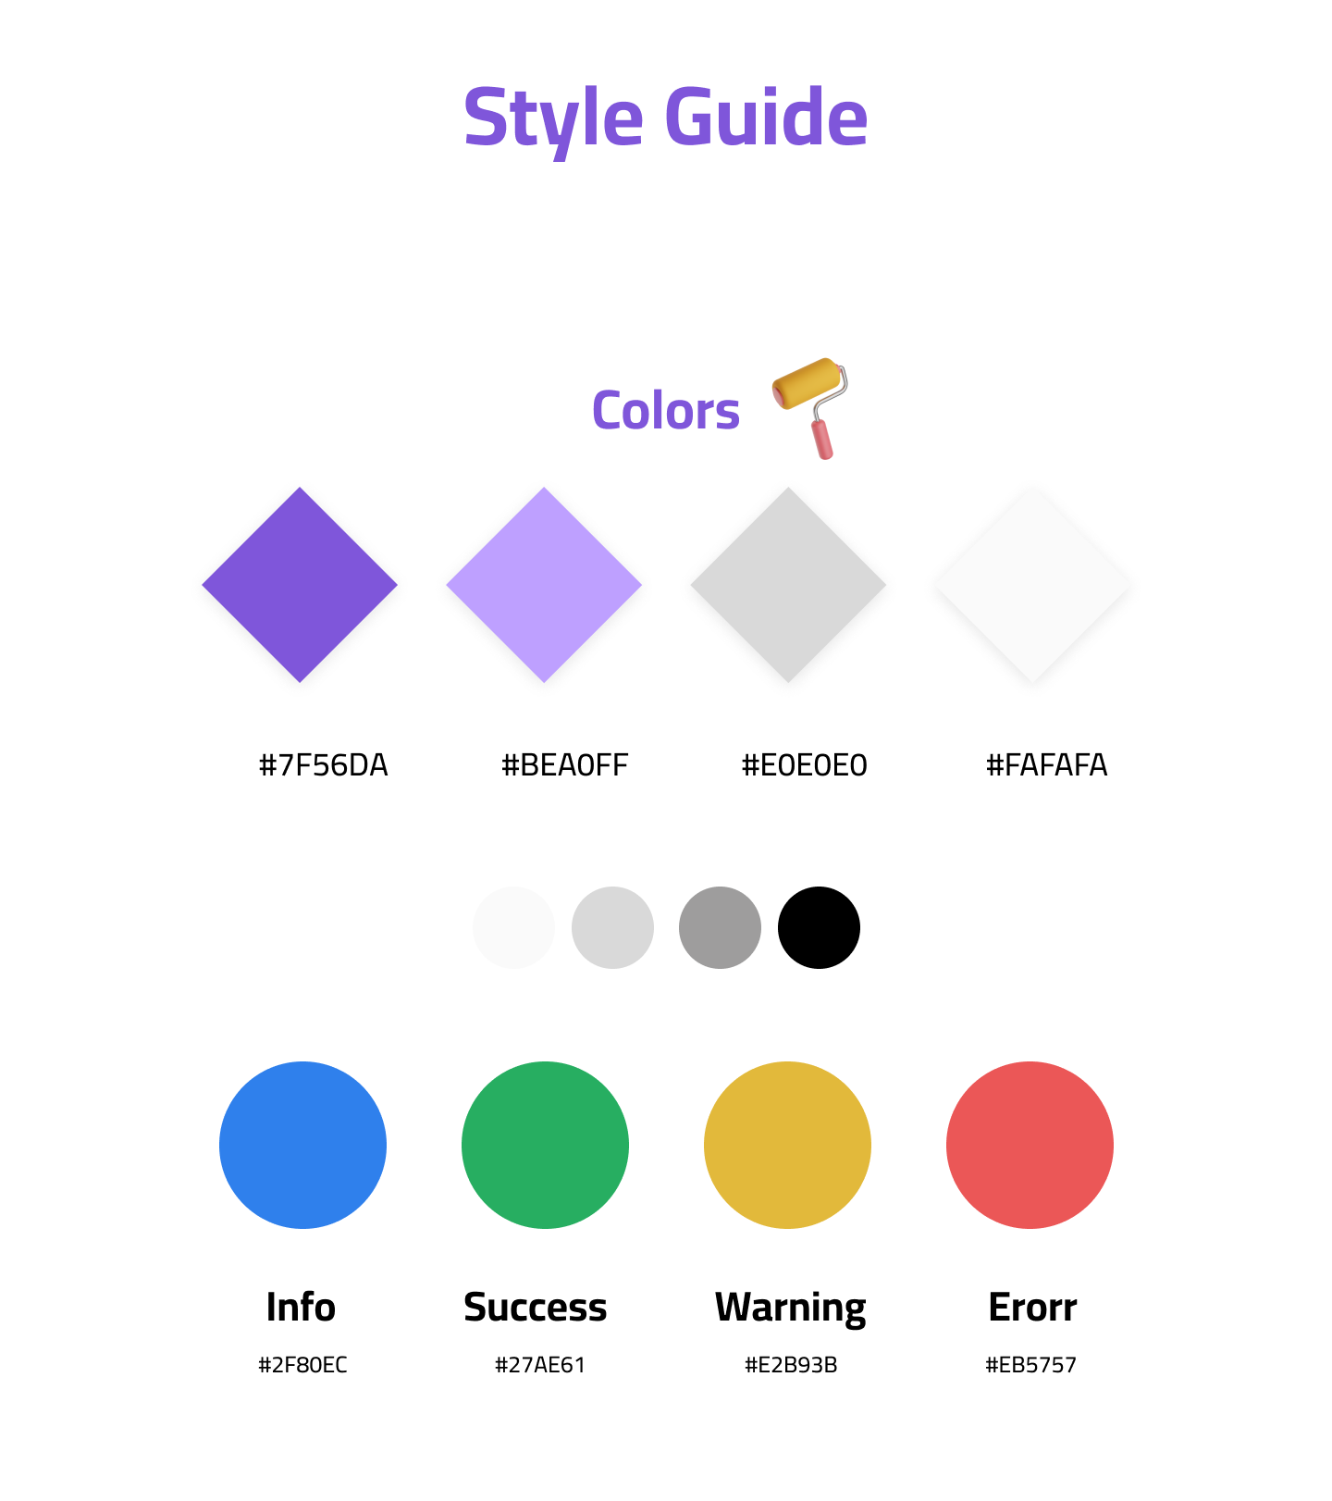
Style guide

Slide 5
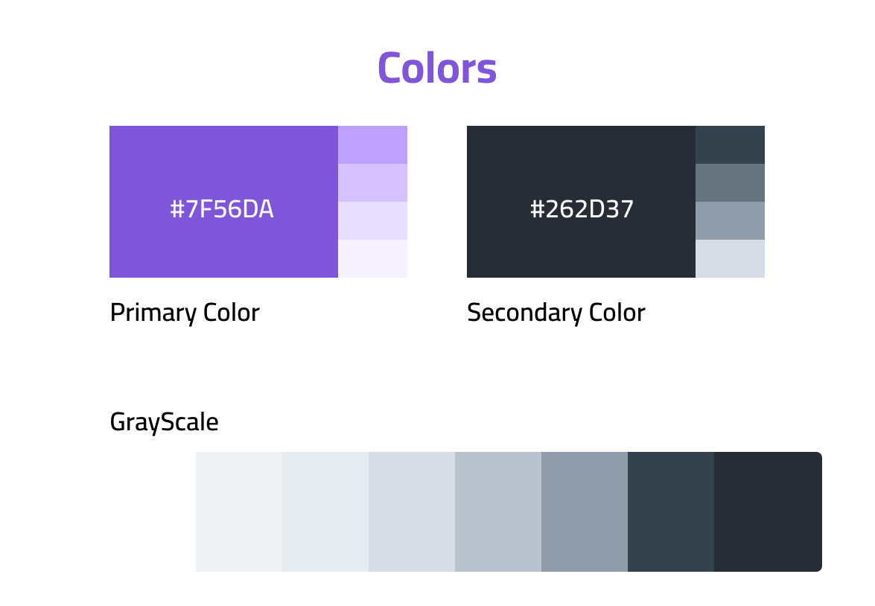
Style guide

Slide 6
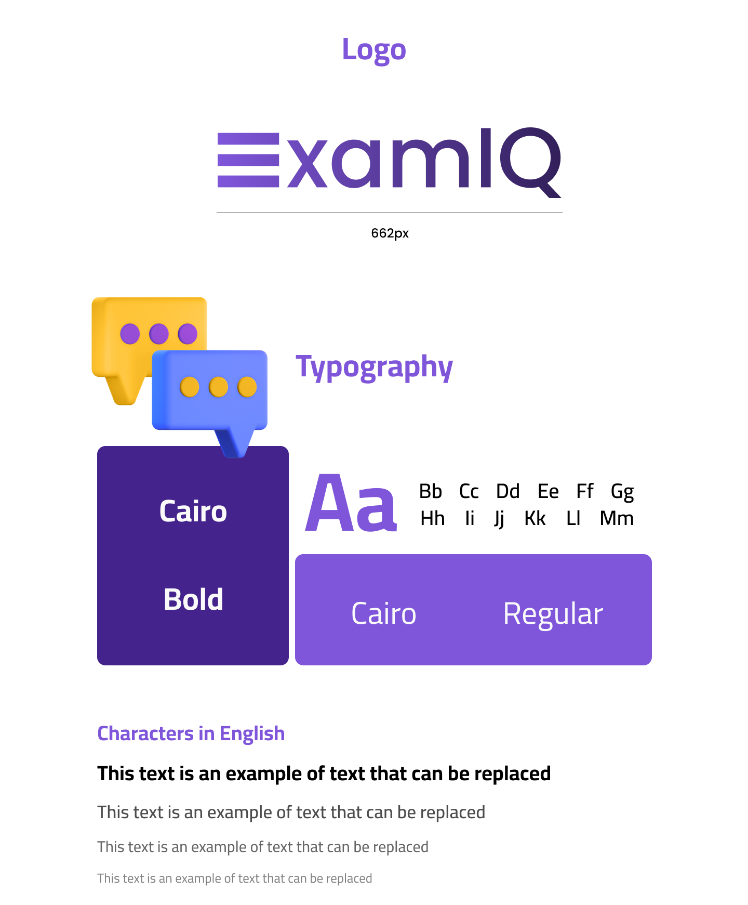
Fonts & Logo

Slide 7
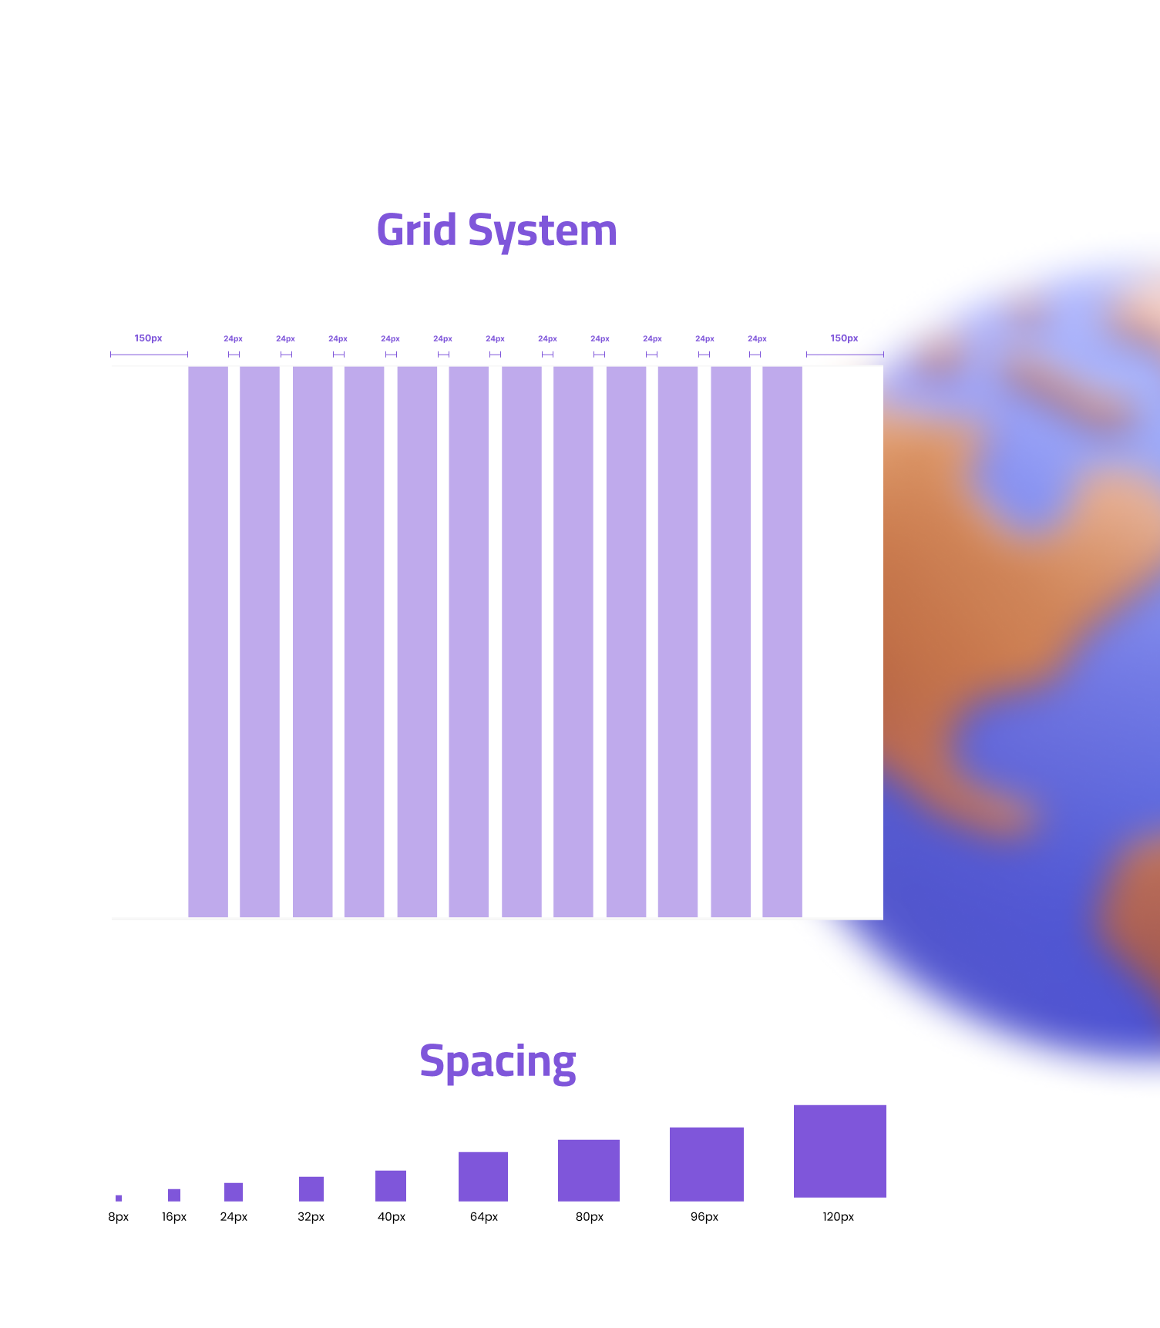
gRID sYSTEM sPACING

Slide 8
Tone of Voice
We adopts a formal tone of voice to convey professionalism and credibility.
Use clear and concise language while maintaining a professional tone.

Slide 9

Images
We utilizes cartoon images to add a touch of friendliness and approachability.
Cartoon images help create a visually appealing and relatable identity.

Slide 10
Tech used
Figma
VS code
LOGO maker
Trello
Github

Slide 11
Workflow
Requirement gathering: determine client needs and identify key features.
Designing our website to be user-friendly and create wireframe and mockup.
Front-end development using HTML,CSS,JavaScript.
Our management includes:
* Daily scrum meeting 15 minutes.
* Separate tasks between team members.
* Update trello board by product owner.

Slide 12

Demo

Slide 13

THANKS
Does anyone have any questions?

